Slide 1
HTML –CSS & JS Crash Course
HTML

Slide 2
What is HTML?
HTML is a markup language for describing web documents (web pages).
HTML stands for Hyper Text Markup Language
A markup language is a set of markup tags
HTML documents are described by HTML tags
Each HTML tag describes different document content

Slide 3
HTML Tags
HTML tags are keywords (tag names) surrounded by angle brackets:
<tagname>content</tagname>
HTML tags normally come in pairs like <p> and </p>
The first tag in a pair is the start tag, the second tag is the end tag
The end tag is written like the start tag, but with a slash before the tag name

Slide 4
Semantic Tags
Semantic tags are HTML 5 tags
The are used for making the layout of the page

Slide 5
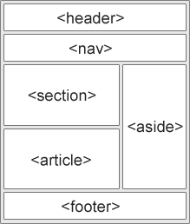
HTML5 Page Layout
HTML5 offers new semantic elements that define different parts of a web page:
<header> - Defines a header for a document or a section
<nav> - Defines a container for navigation links
<section> - Defines a section in a document
<article> - Defines an independent self-contained article
<aside> - Defines content aside from the content (like a sidebar)
<footer> - Defines a footer for a document or a section
<details> - Defines additional details
<summary> - Defines a heading for the <details> element

